Slide 1
SAP Ariba Commerce Automation Manual

Slide 2
CONTENT
SAP Ariba Commerce Automation Overview
SAP Business Network Invitation and Registration
SAP Business Network Project Scope
Advance/Down Payment and Other Incoterms Invoices (BTP Platform)
Additional Resources

Slide 3
SAP Ariba Commerce Automation Overview

Slide 4
What is SAP Ariba Commerce Automation?
Goals: Why this Change Occurring?
1
Provide Real-Time Supplier Communication Channel.
As part of Advanced Petrochemical Company’s Digital Transformation Journey, a cloud-based platform (SAP Ariba Commerce Automation) has been implemented to automate the entire procure-to-pay process, from requisitioning goods or services to paying suppliers.
2
Submitting Documents/Invoices Securely.
3
Real-Time Transactions Updates.
4
Faster Financial Transactions.
Scope: What is Changing?
Entire, procure-to-pay process will be automated from purchase order placement to suppliers' payment processing.
No emails, no manual POs, and easy to use systems with real time transaction updates and notifications.
Faster approvals through automated workflows.
Seamless data search & retrieval.

Slide 5
Expectations: What Should Suppliers Do?
Compliance: Will this Change be Required?
Prerequisite: all suppliers must be fully registered with Advanced in SLP Ariba
You will receive an automated invitation link through email from SAP Business Network.
All the documents including Purchase Order, Order Confirmation, invoices and Service Entry Sheets will be transacted through the SAP business network.
This is a mandatory change for all registered suppliers, they should acknowledge the invitation to the SAP Business Network.
Starting from 16th Feb 2025 (Go-live date), all documents such as POs, Invoices, and SESs documents will be processed through the system. Therefore, email communication will not be accepted.
Timeline: When this change will be effective?
The Go-live Date is 16ᵗʰ Feb-2025

Slide 6
Expectations: What Should Suppliers Do?
Compliance: Will this Change be Required?
Prerequisite: all suppliers must be fully registered with Advanced in SLP Ariba.
You will receive an automated invitation link through email from SAP Business Network.
All the documents including Purchase Order, Order Confirmation, invoices and Service Entry Sheets will be transacted through the SAP business network.
This is a mandatory change for all registered suppliers, they should acknowledge the invitation to the SAP Business Network.
Starting from 16th Feb 2025 (Go-live date), all documents such as POs, Invoices, and SESs documents will be processed through the system. Therefore, email communication will not be accepted.
Timeline: When this change will be effective?
The Go-live Date is 16ᵗʰ Feb-2025

Slide 7
Proposals & Questionnaires vs. Business Network
Suppliers will be invited to Proposals & Questionnaires (Sourcing) for:
Suppliers are required to use Business Network for:
Request for Proposals
Receive Purchase Orders
Send electronic documents
Advance Payment and Other Incoterm Invoices
Contracts

Slide 8
Next Steps
Proposals & Questionnaires
Supplier Summit
Invitation to SAP Business Network
Create Account or Login
Registration Questionnaire
Business Network
First Purchase Order via Email
Enablement Tasks
Ready to Transact with your Customer

Slide 9
SAP Business Network Invitation and Registration

Slide 10
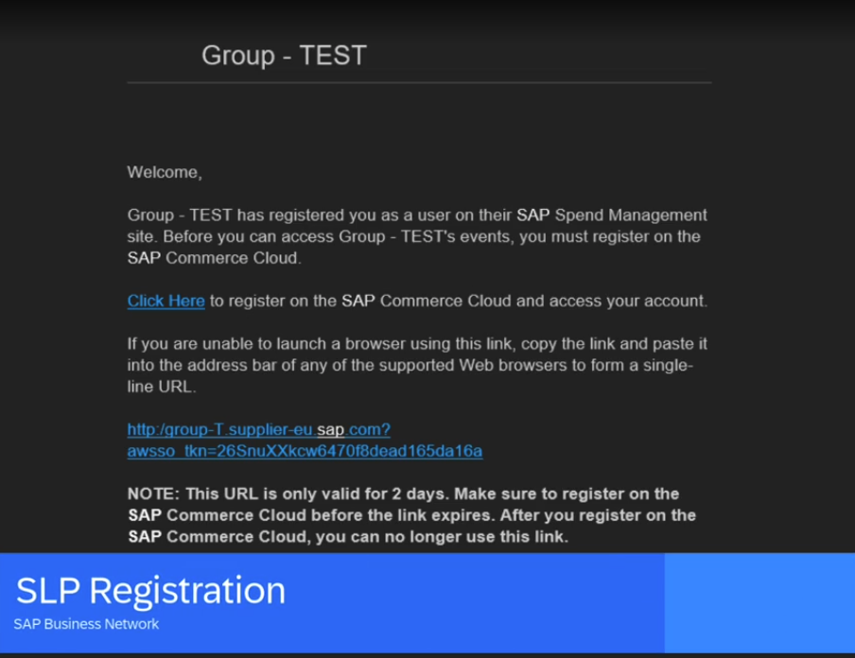
SAP Business Network Invitation and Registration
1
On receiving the invitation email from Advanced, follow the below steps:
Click on the link mentioned as “Click Here”
Based on the SAP account that you may have, you may select any of the buttons

Slide 11
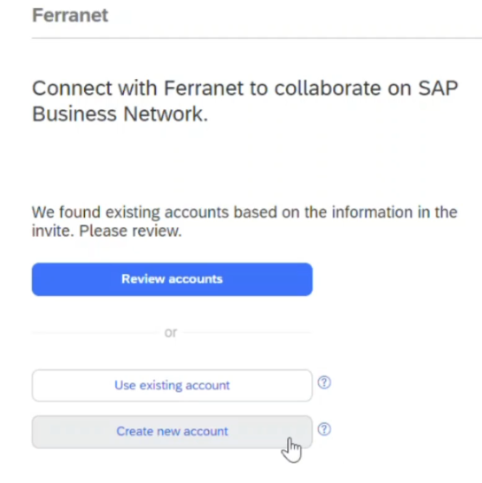
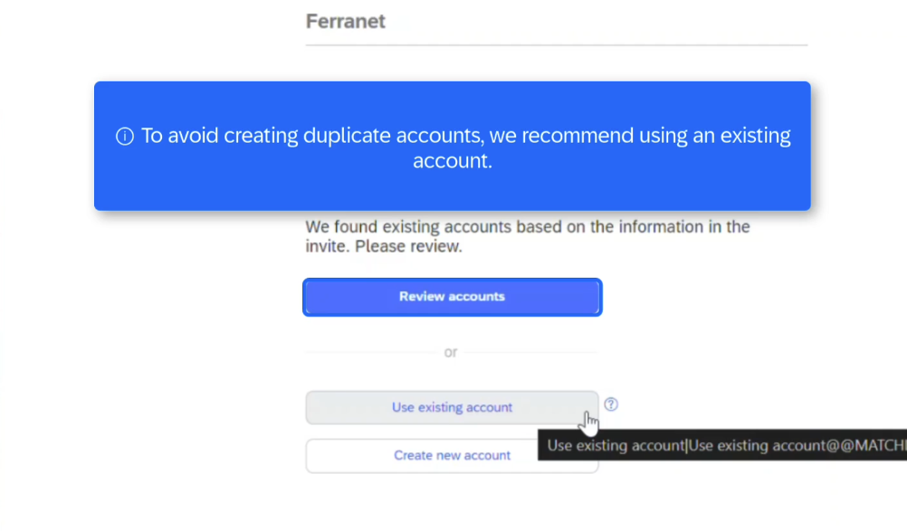
SAP Business Network Invitation and Registration
2
3
Click on “Review accounts” to check if your organization already has an SAP Account and avoid creating duplicate accounts.
Click on “Use existing account” to link your existing organization SAP Account.
Click on “Create new account” to create a new SAP Account for your organization.

Slide 12
SAP Business Network Project Scope

Slide 13
SAP Business Network Project Scope
In Scope for Advanced with SAP Business Network:
Purchase Orders
Order Confirmations
Goods Receipt
Ship Notices
Service Entry Sheets
P/O Invoices
Service Invoices

Slide 14
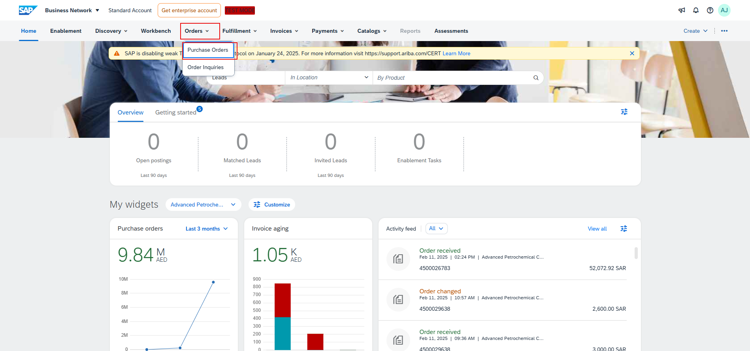
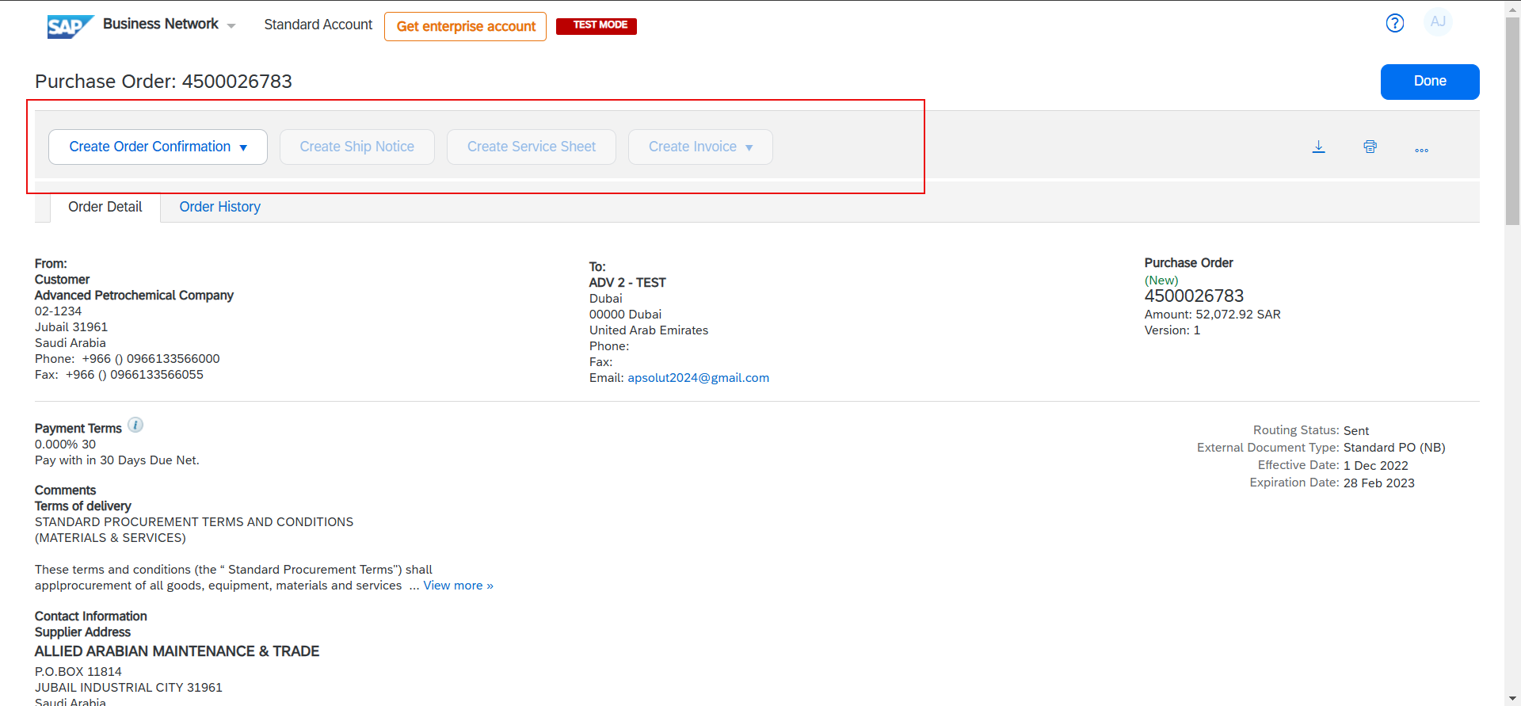
View Purchase Order
1
Log in to your Ariba Account.
Access the Purchase Order from the Orders tab.
2
3. Click on the Purchase Order to create purchase order confirmation, Service Entry Sheet and Invoice.

Slide 15
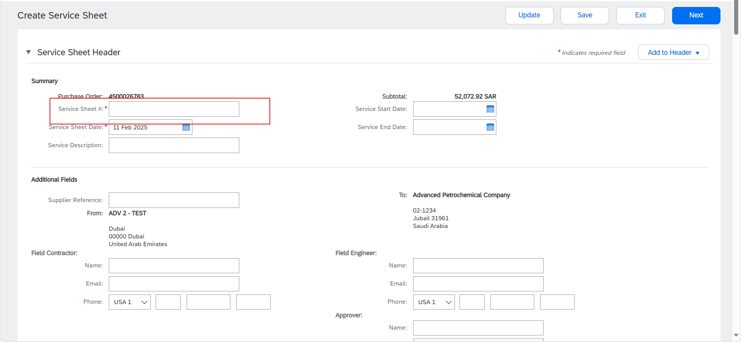
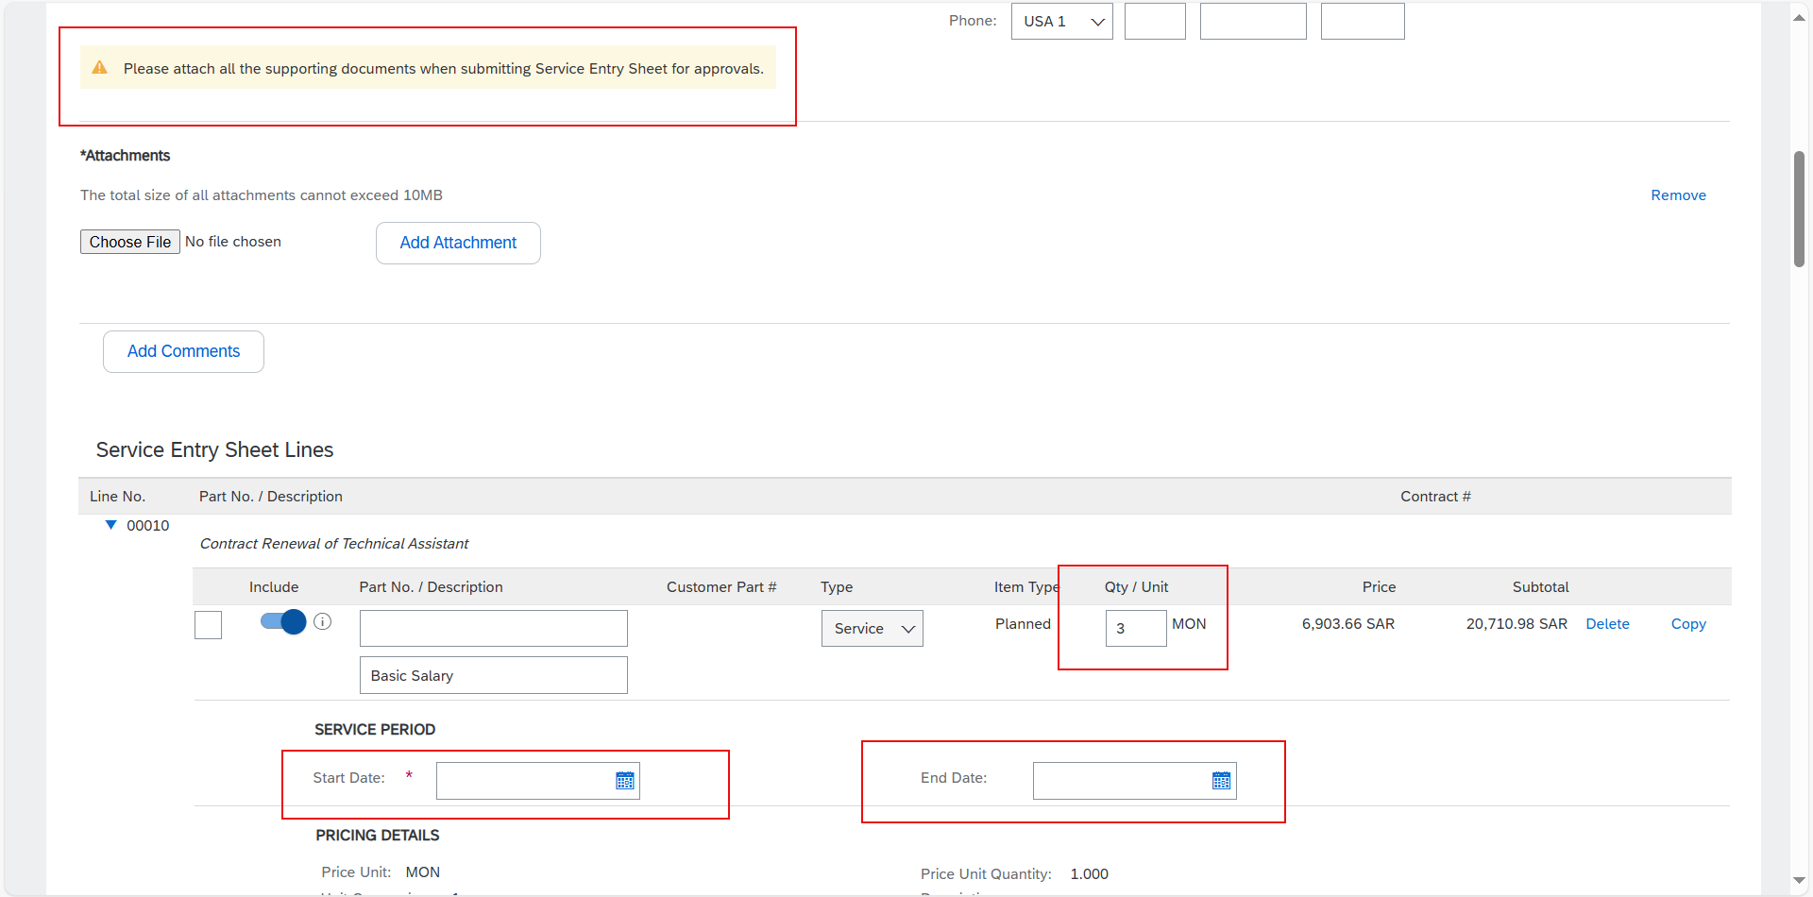
Service Entry Sheet Creation
1
Open the PO to create Service Entry Sheet.
Service Entry Sheet after submitted will be sent for Approvals.
2
3. When submitting Service Entry Sheet, all supporting documents needs to be attached (Work Completion, Invoice copy Etc.)

Slide 16
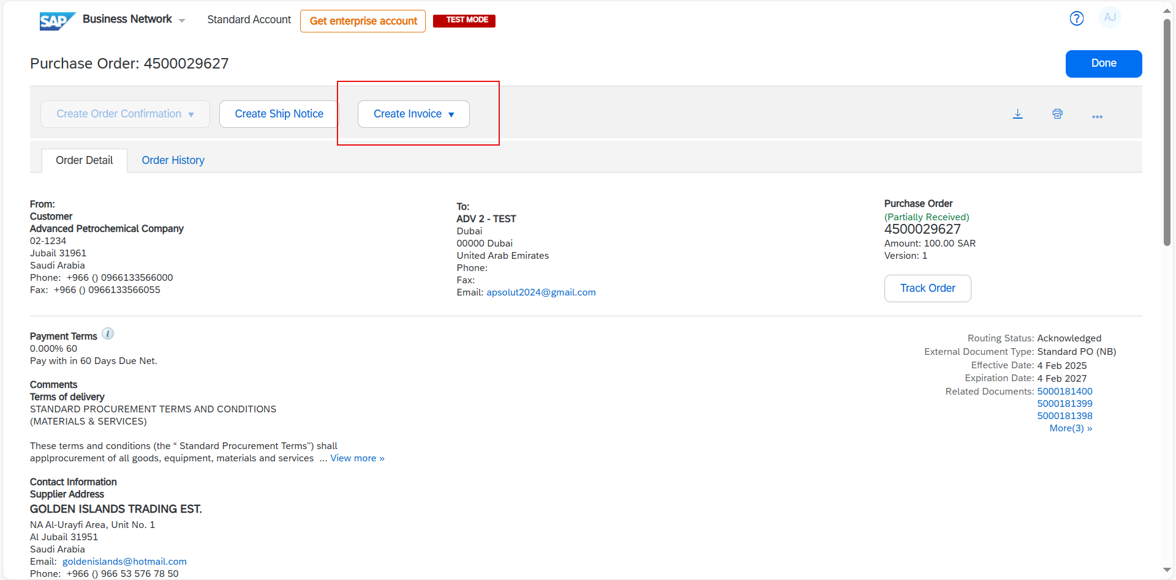
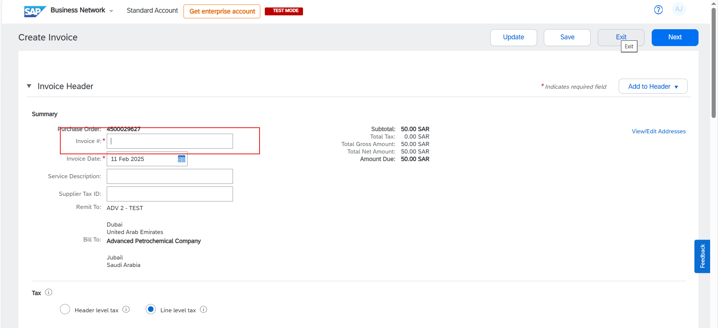
View/Submit Invoice
1
Open the PO and click on Create Invoice.
Invoice can be created only after the SES approvals.
2
3. When submitting Invoice, all supporting documents needs to be attached (Work Completion, Invoice copy Etc.)

Slide 17
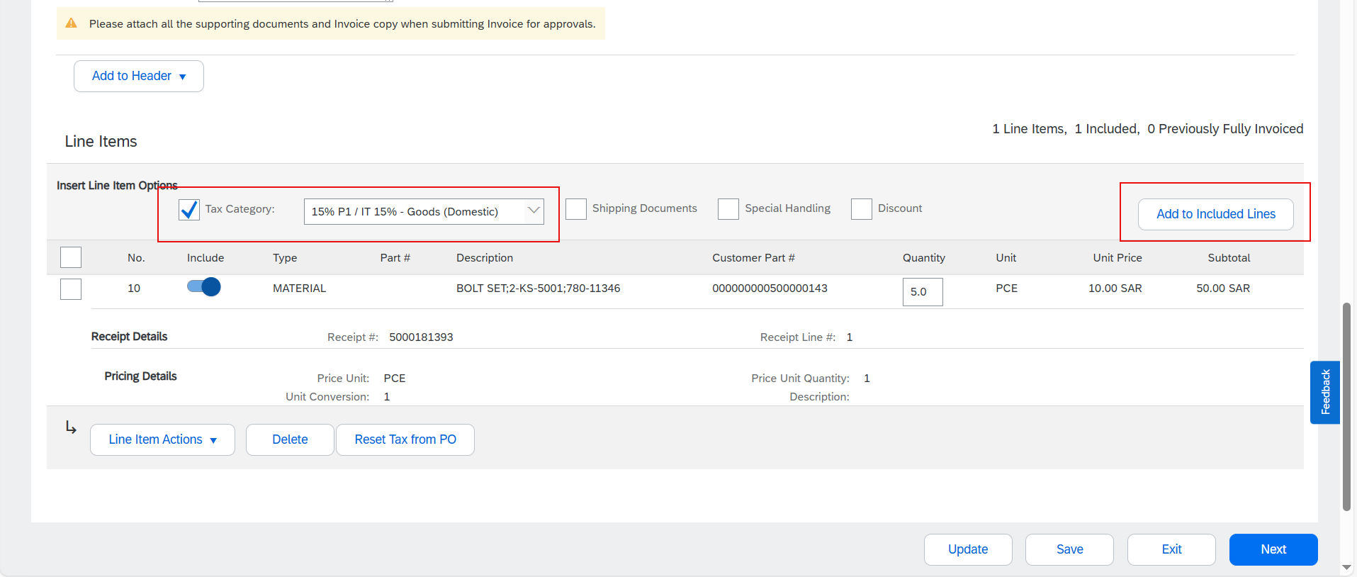
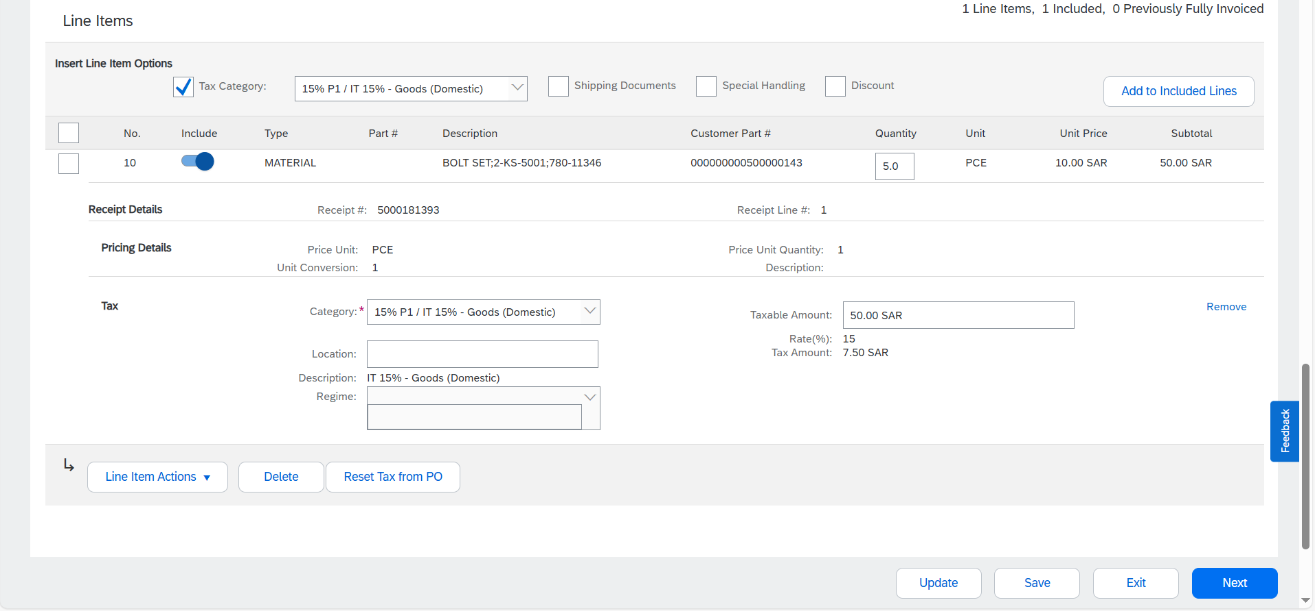
Invoice – Selection of Tax Category
1
Select the Tax category from the dropdown and click on add to individual lines.
2
2. The Tax value will be added to the line item. Right tax code should be selected for faster approvals.

Slide 18
Advance/Down Payment and Other Incoterms Invoices (BTP Platform)

Slide 19
Expectations: What Should Suppliers Do?
Compliance: Will this Change be Required?
Prerequisite: all suppliers must be fully registered with Advanced Ariba Portal.
Invoices for Advance/Down Payment and Other Incoterm where the payment is needed prior the goods delivery will be processed through the BTP platform.
This is a mandatory change for all registered suppliers, they should login to the Business Network and access the URL for the Advance/Down payment Invoice creation.
Starting from 02 Mar 2025 (Go-live date), all the advance/down payment Invoice should be submitted from the BTP platform. URL will be in the Business Network to access.
No separate registration is required for the BTP platform.
Advance/Down Payment Invoices submitted through email will not be considered.
Timeline: When this change will be effective?
The Go-live Date is 2nd Mar 2025

Slide 20
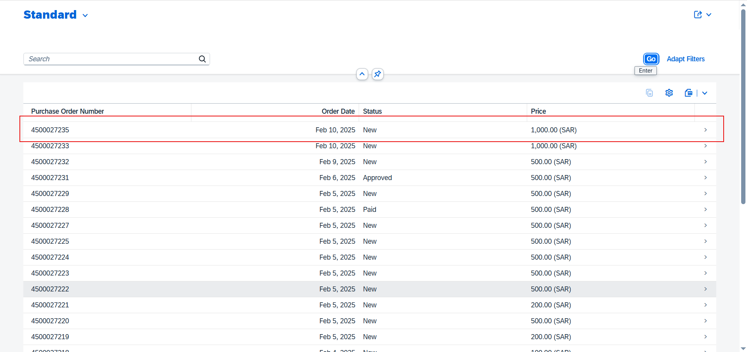
View Purchase Orders
1
Log in to your Ariba Account.
Click on URL to access the Advance payment portal.
Supplier will be navigated to the Advance payment application.
Supplier can see the POs applicable for Advance payment or Other Incoterm Invoices.

Slide 21
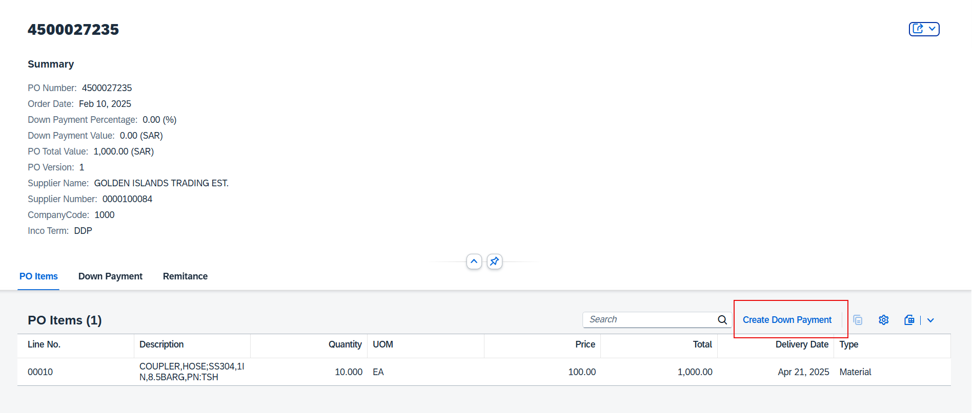
Create Down/Advance Payment
1
Click on the Purchase Order Number.
Click on Create Down Payment to create an Advance payment invoice.
Once created the Advance Payment or other Incoterm Invoice will be sent for Advanced Team Approvals.

Slide 22
Additional Resources

Slide 23
Additional Resources
How to use and transact on SAP Business Network
Account Overview and Administration
Account Overview – Use and customize your account
User Creation – Create and administrate account users
Get Enterprise Account – Review why and how to upgrade your account
Help Center – Utilize the Help Center
Advanced Transactional Process
Order Confirmation – Create an Order Confirmation
Advance Ship Notice – Create a Ship Notice
PO Invoice – Create an Invoice for a material order
Service Entry Sheet – Create a Service Entry Sheet
Service Invoice – Create an Invoice for a service order

Slide 24
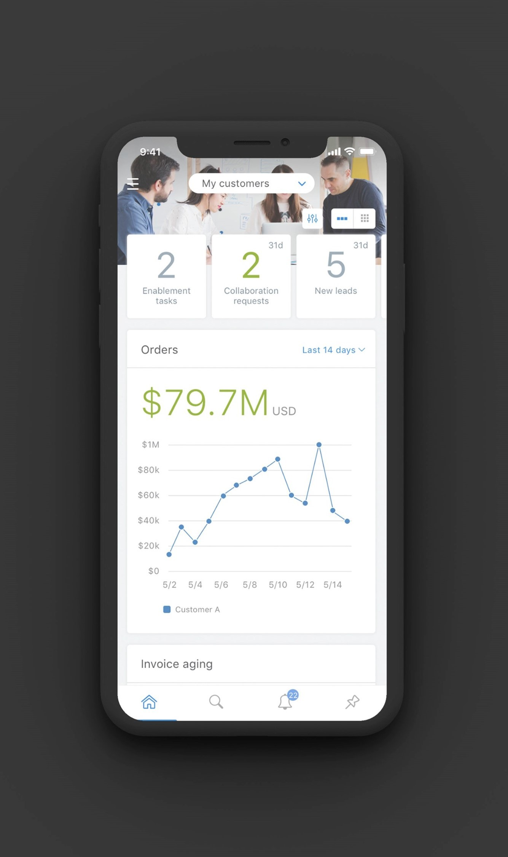
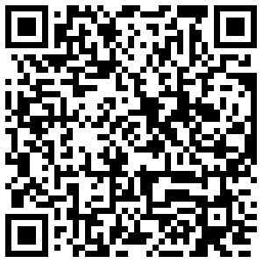
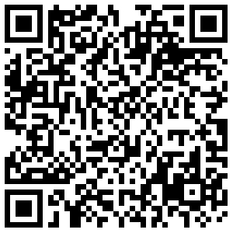
Supplier Mobile App
SAP Business Network Supplier mobile app helps suppliers take their business on-the-go. Regardless of the account type, suppliers can stay connected with their customers on their iPhone or Android devices.
Key mobile app features
Get real-time notifications
Create documents on-the-go
Find documents fast
Improve invoice visibility
App Store
Google Play
With quick and easy biometric login and availability in over 24 languages, the mobile app is the best way to be more responsive and better informed.
LEARN MORE

Slide 25
Thanks

